Slide 1
Introduction to JavaScript (Part 1)
Day 3

Slide 2
Recap
We learned how to write HTML in order to add content to our web pages
HTML uses tags to describe document structure.
We then learned how to write CSS in order to style our content
CSS uses selectors and property-value pairs to define styling.
Today, we will use JavaScript in order to add interactivity to our pages
JavaScript is a entire programming language, like Python.
Notes:
http://diana-adrianne.com/purecss-francine/x

Slide 3
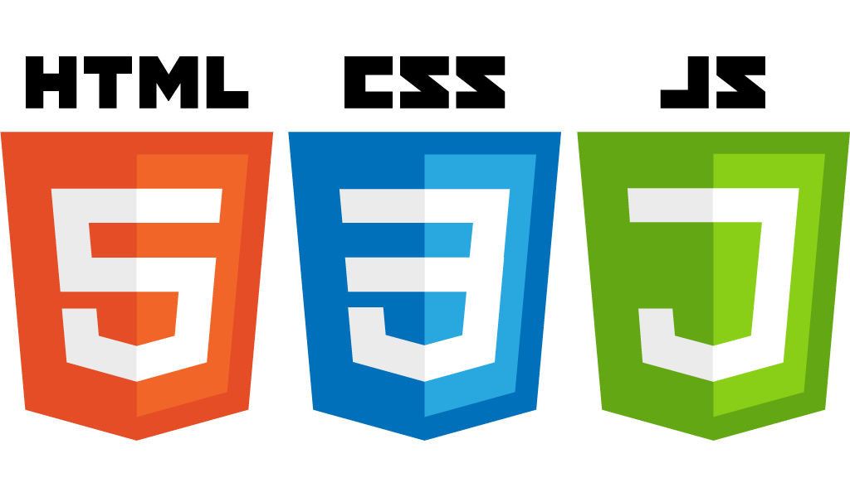
Content
Appearance
Interaction

Slide 4
What can I do with JavaScript?
Graphs and Visualizations — d3.js
go.meet.sh/planets
Games and Animations — p5.js
go.meet.sh/p5tiles
Machine Learning — tensorflow.js
go.meet.sh/tfplay

Slide 5
JavaScript is NOT Java
They have similar names, but are completely unrelated
JavaScript is a interpreted language (“on the fly”) by your browser
Java is a compiled language (“beforehand”)
JavaScript is much more lightweight than Java

Slide 6



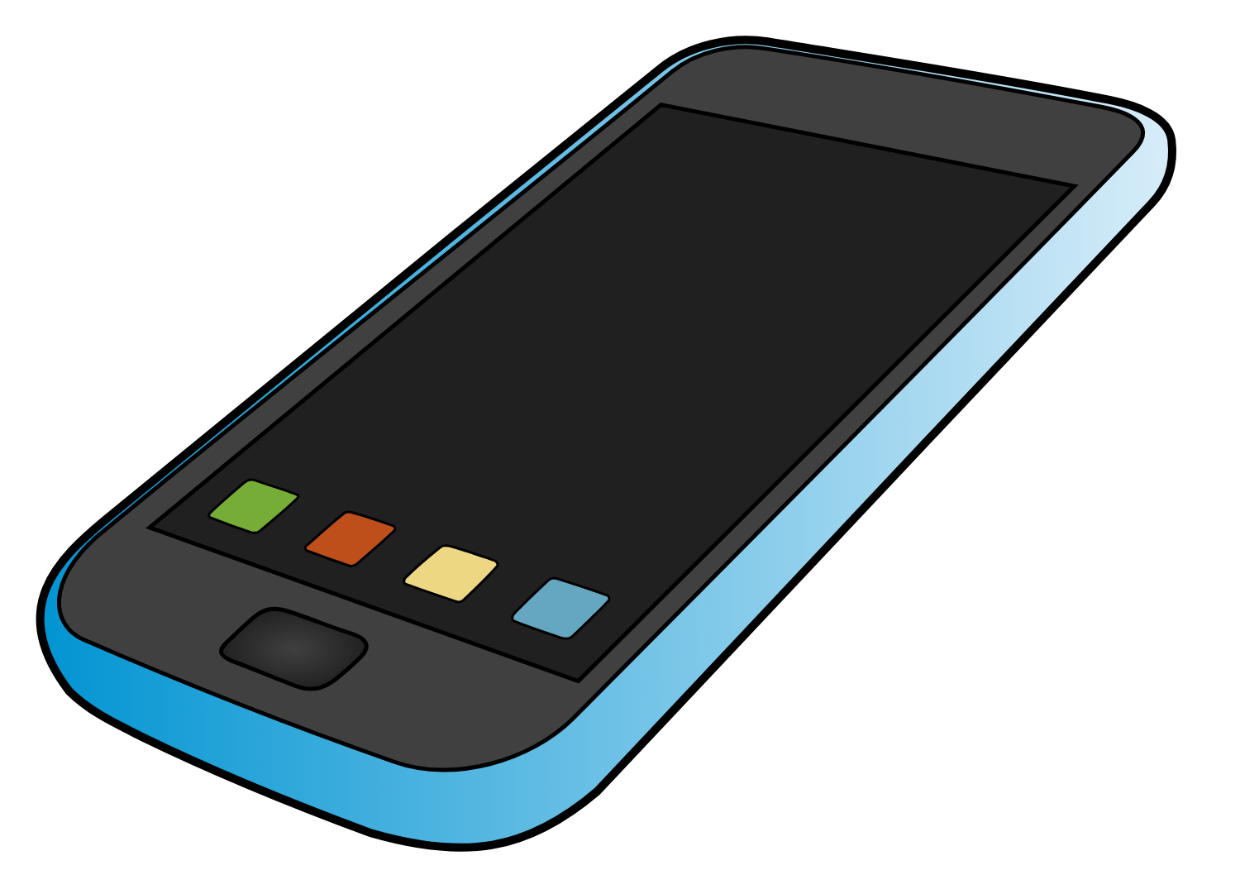





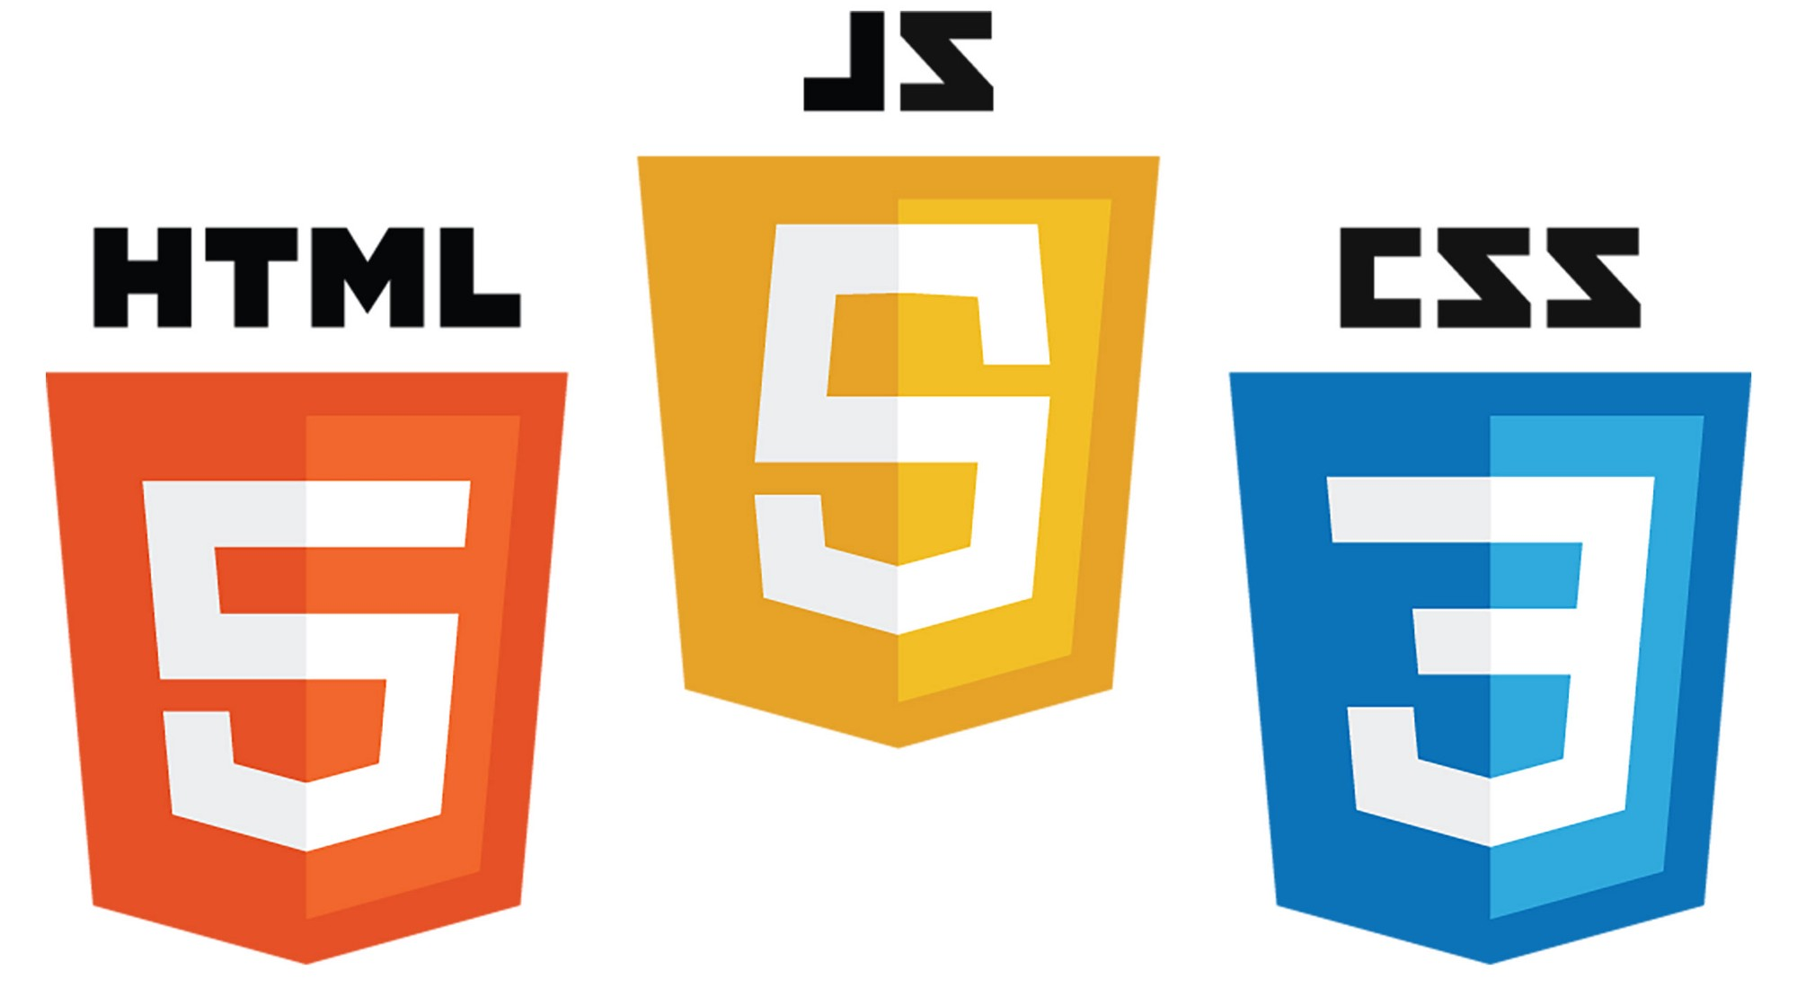

Frontend
(Client)
Request
Backend
(Server)
Response
Internet

Slide 7
Frontend
(Client)
Request
Backend
(Server)
Response
Internet

Slide 8
What is JavaScript?
JavaScript (“JS”) is a programming language
JS uses events and actions to make your web page interactive (“dynamic”)

Slide 9
Download the Exercises
go.meet.sh/js-labs1
Fork the exercises on Github
In terminal, change directory to Desktop:
cd ~/Desktop
Clone the repository (replace <username> with your Github username):
git clone https://github.com/<username>/y2s18-intro-js-1
You should have a folder on your Desktop called y2s18-intro-js-1

Slide 10
JavaScript and HTML

Slide 11
Adding JavaScript to HTML (1)
<html>
<head> ... </head>
<body>
<h1>My HTML Page</h1>
<p>My paragraph</p>
<script>
// your code here
</script>
</body>
</html>

Slide 12
User I/O

Slide 13
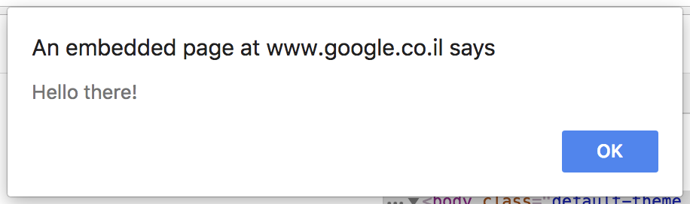
Alert
alert(“Hello there!”);

Slide 14
User I/O (1)
alert(“Your message here”);
prompt(“Your question here”);
document.write(“Your second message here”);
console.log(“Your last message here”);

Slide 15
Demo: “Hello, world!”
go.meet.sh/jshello

Slide 16
User I/O (2)
alert(“Your message here”); // show a popup
prompt(“Your question here”); // get user input
document.write(“Your second message here”); // show on page
console.log(“Your last message here”); // show in console

Slide 17
Try it Yourself — User I/O
Lab (Section 1.1): hello-world
Slides: go.meet.sh/js-slides1
Cheatsheet: go.meet.sh/js-cheat

Slide 18
Variables

Slide 19
Variables (1)
A variable is a value that can change, depending on conditions or on information passed to the program
In other words, something that stores a value
In JavaScript, we declare variables with the var keyword.

Slide 20
Variables (2)
var myLuckyNumber = 14; // declare a variable
var myName = “Matthew”; // declare a variable
myName = “Matt”; // edit an already declared variable

Slide 21
Data Types
Numeric
3, 3.14, NaN, Infinity, 6.022e23
String
“Hello!”, “lunch and dinner”, “JavaScript”
Array
[]
[1, 4, 9, 16, 25]
[“cat”, “dog”, “fish”]
[1, “soup”, [“a”, “b”], 3, 19]
Object

Slide 22
Operators
+ | Addition (or “Concatenate”) | += | x = x + a
- | Subtraction | -= | x = x - a
* | Multiplication | *= | x = x * a
/ | Division | /= | x = x / a
% | Modulus (Remainder) | %= | x = x % a
++ | Increment (Add 1)
-- | Decrement (Subtract 1)

Slide 23
Demo: Variables
go.meet.sh/js-vars

Slide 24
Numbers
In JavaScript, floats and integers are both considered the same data type, Number.
Number.toString() // convert number to string
Number.toFixed(<digits>) // fixed number of decimal places
Number.toPrecision(<digits>) // fixed number of digits

Slide 25
Demo: Numbers
go.meet.sh/js-numbers

Slide 26
Strings (1)
Like Python, strings in JavaScript can be created with either single or double quotes.
parseInt(<string>) // convert from String to integer (Number)
parseFloat(<string>) // convert from String to floating point (Number)
String.trim() // remove whitespace from the beginning and ending of a string

Slide 27
Strings (2)
String.substring(<a>, <b>) // return the characters between positions a and b, excluding b
String.toUpperCase() // capitalize all the characters
String.toLowerCase() // turn all characters into lowercase
var a = "This is a string"
0
1
2
3
4
5
6
7
8
9
10
11
12
13
14
15

Slide 28
Demo: Strings
go.meet.sh/js-strings

Slide 29
Try it Yourself — Variables
Lab (Section 1.2): vars
Slides: go.meet.sh/js-slides1
Cheatsheet: go.meet.sh/js-cheat

Slide 30
Arrays

Slide 31
Arrays (1)
var colors = [“red”, “yellow”, “tree”, “blue”];
colors[2] = “green”;
colors[6] = “pink”;
colors.push(“purple”); // add to the end of the array
colors.splice(1, 0, “orange”); // insert into array
"red" | "yellow" | "green" | "blue" | undefined | undefined | "pink"
0
1
2
3
4
5
6
"red" | "orange" | "yellow" | "green" | "blue" | undefined | undefined | "pink"
0
1
2
3
4
5
6
7

Slide 32
Arrays (2)
var fruits = "pineapple, banana, orange";
fruits = fruits.split(", "); // turn String into Array
fruits.sort(); // changes the array!
fruits.reverse(); // changes the array!
var sortedFruits = fruits.join(", "); // turn Array back into String

Slide 33
Demo: Arrays
go.meet.sh/js-arrays

Slide 34
Arrays (3)
Arrays are lists of items
Array.push(<item>); // add <item> at the end of the array
Array.splice(<pos>, 0, <item>); // insert <item> at position <pos> in the array
Array.sort(); // sort the array
Array.reverse(); // reverse the array

Slide 35
Try it Yourself — Arrays
Lab (Section 1.3): arrays
Labs: go.meet.sh/js-labs1
Slides: go.meet.sh/js-slides1
Cheatsheet: go.meet.sh/js-cheat

Slide 36
Conditionals

Slide 37
“if” statement (1)
if (condition) {
// do something
}
if (condition) {
// do something
} else if (condition 2) {
// do something else
}

Slide 38
“if” statement (2)
if (condition) {
// do A
} else {
// otherwise do B
}
if (condition) {
// do A
} else if (condition 2) {
// do B
} else {
// otherwise do C
}

Slide 39
“if” statement (3)
var age = prompt("What is your age?");
if (age <= 12) {
alert("You are a grade schooler");
} else if (age <= 18) {
alert("You are a teenager");
} else {
alert("You are an adult");
}
source: https://www.healthychildren.org/english/ages-stages/Pages/default.aspx

Slide 40
Comparisons
== | Equals | >= | Greater than or equal to
!= | Not equals | <= | Less than or equal to
=== | Strict equals (value and type) | && | Logical AND
!== | Strict not equals | || | Logical OR
> | Greater than | ! | Logical NOT
< | Less than | ? : | Ternary operator

Slide 41
“switch” statement
switch (variable) {
case value1:
// do stuff
break;
case value2:
// do other stuff
break;
default:
// do this if no other case matches
}

Slide 42
Demo: Conditionals
go.meet.sh/js-conds

Slide 43
Loops

Slide 44
“for” loop (1)
for (initializer; condition; increment) {
// your code goes here
}

Slide 45
“for” loop (2)
for (var i = 0; i < 10; i++) {
console.log(i);
}

Slide 46
“while” loop (1)
initializer
while (condition) {
// your code goes here
increment
}

Slide 47
“while” loop (2)
What’s the first number greater than 10 that leaves a remainder of 2 when divided by 3, and has a square that leaves a remainder of 1 when divided by 7?

Slide 48
Demo: Loops
go.meet.sh/js-loops

Slide 49
“while” loop (3)
var i = 10;
while (!(i % 3 == 2 && (i * i) % 7 == 1)) {
i++;
}
console.log("The answer is:", i);

Slide 50
Try it Yourself — Loops
Lab (Section 1.4): loops
Slides: go.meet.sh/js-slides1
Cheatsheet: go.meet.sh/js-cheat

Slide 51
Functions

Slide 52
What are functions?
In programming, a function is a section of a program that performs a specific task.

Slide 53
Why use functions?
The DRY principle: Don’t Repeat Yourself
Makes the code easier to understand with descriptive names

Slide 54
Functions (1)
function functionName() {
// do stuff
}

Slide 55
Functions (2)
function sayHello() {
console.log("Hello!");
}
function square(x) {
return x * x;
}
function calculateDistance(x1, y1, x2, y2) {
return Math.sqrt(square(x1 - x2) + square(y1 - y2));
}

Slide 56
Demo: Functions
go.meet.sh/js-funcs

Slide 57
Try it Yourself
Lab (Section 1.5): functions
Slides: go.meet.sh/js-slides1
Cheatsheet: go.meet.sh/js-cheat

Slide 58
Error Handling
(Extra)

Slide 59
What is error handling?
Error handling is the anticipation, detection, and resolution of programming, application, and communications errors
Programming Bugs in code
Application Input given by user is badly formatted
Communication Not connected to the Internet

Slide 60
“try .. catch ..” (1)
try {
// code that might go wrong
} catch (error) {
// do something with the error, like print it out
}

Slide 61
“try .. catch ..” (2)
var num;
try {
num.someFunction();
} catch (error) {
console.log(error.message);
}

Slide 62
“throw”
throw new Error(“message of what went wrong”);

Slide 63
“try .. catch ..” (2)
var a = prompt("Give a value for 'a': ");
var b = prompt("Give a value for 'b': ");
try {
if (b == 0) {
throw new Error("Can't divide by 0");
}
var ans = a / b;
console.log(a, "/", b, "=", ans);
} catch (error) {
console.log(error.message);
}

Slide 64
Demo: Error Handling
go.meet.sh/js-errors

Slide 65
Key Takeaways
JS uses events and actions to make your web page interactive (“dynamic”)
You can include JavaScript in your webpage using
<script>
// your code
</script>
See all the JavaScript syntax you learned at go.meet.sh/js-cheatsheet

